Slide 1
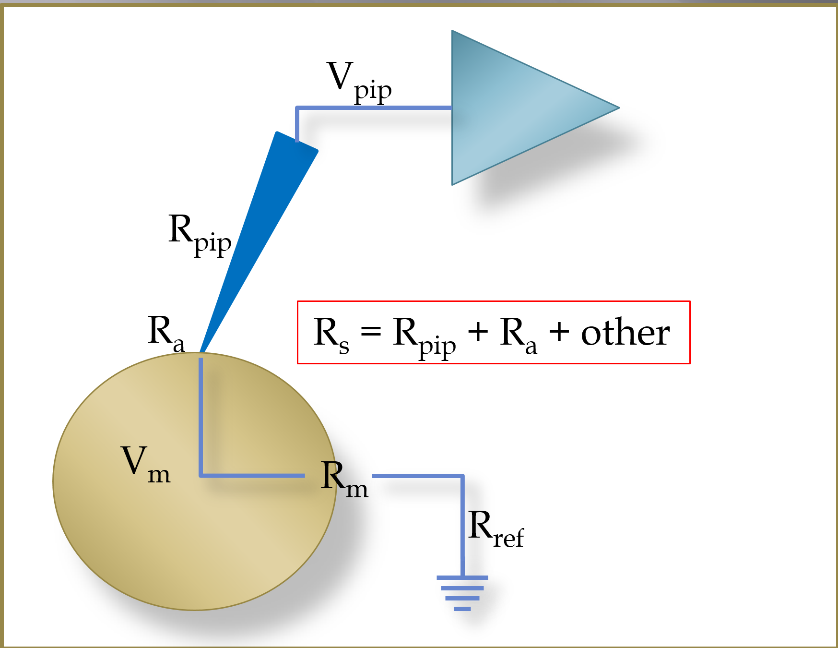
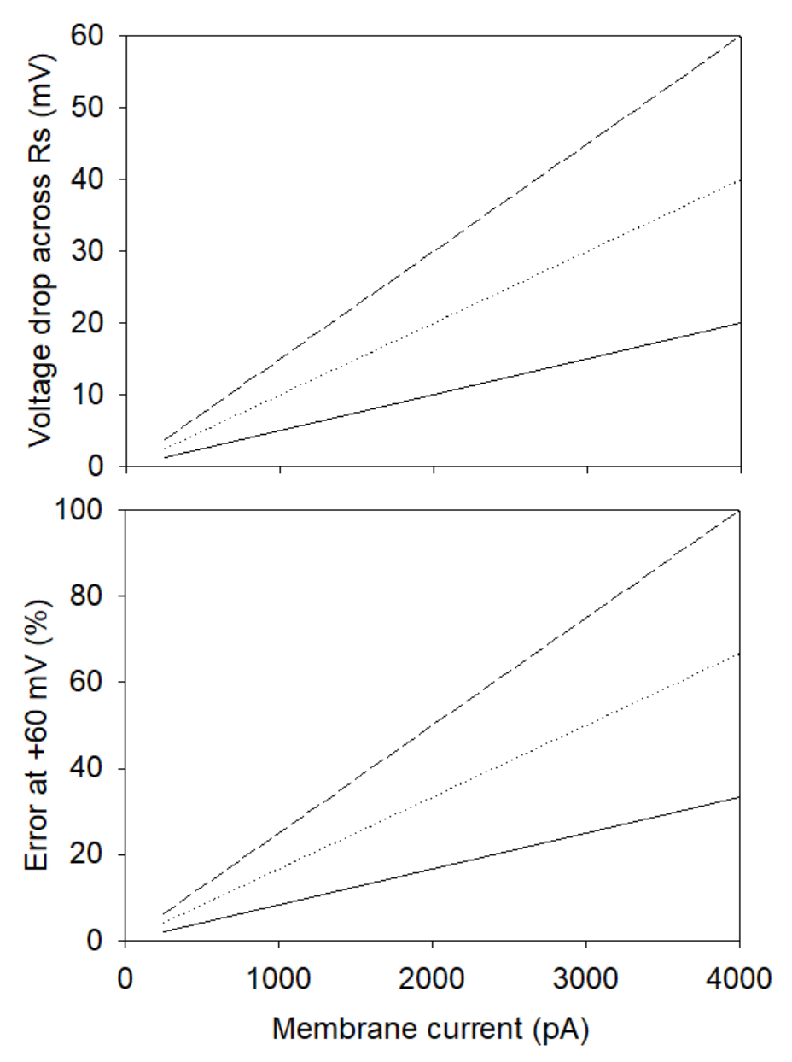
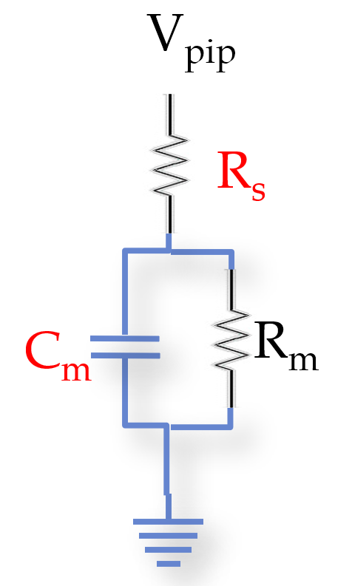
Single Electrode Voltage Clamping with the Patch Clamp Technique is Far From Perfect
“Series resistance and space clamp artifacts can render worthless the handsomest results once they are subjected to critical review”
CLAY M. ARMSTRONG and WILLIAM F. GILLY
I have heard about series resistance. What is it anyway?
That sounds bad! Is there any way to minimize this error?
Series resistance is the sum of all of the resistances between the input of the patch clamp amplifier (blue triangle) and the cell membrane. It is the sum of the pipette resistance (R_{pip}), any access resistance, R_{a} and other forms of resistance located between the pipette tip and the interior of the cell.
Absolutely! The first and most important step is prevention. The second is correction.
Prevention:
We have seen the error depends on the size of both R_{s} and C_{m}. The secret sauce is to keep these values low, if at all possible. Smaller cells have smaller membrane capacitances. The value of R_{s} can be minimized by using pipettes with low resistances and making sure that the ‘break-ins’ are good. Most importantly, decide on an upper limit for access resistance (R_{a}) of the cell type being used. Use that as an exclusion criterion and do not include data from cells with high values of R_{a}.
Correction:
Modern patch clamp amplifiers provide R_{s} and C_{m} compensation. It is not an option to use this correction, it is vital to do so.
The basis of the correction is to supercharge the command step. Once we have knowledge of the values of R_{s} and C_{m}, the amplifier can put out an excess of current through R_{s} in order to (hopefully) control V_{m}. On the Axopatch amplifier, for example, a brief “charging” pulse may be applied to V_{m}, so that V_{m} may reach its final value quicker (“prediction”). Note that this type of correction does not correct for R_{s}. The “correction” algorithm supercharges the command voltage with a signal proportional to the measured current. In practice, full compensation is not possible, but compensation must be maximized.
So, what makes series resistance bad?
The patch clamp amplifier is doing a fantastic job at clamping the voltage at the silver wire inside the patch pipette (V_{pip}). It does not, however, clamp the voltage inside the cell (V_{m}). Any current that flows from the amplifier to the cell must pass through the series resistance. There is a voltage drop across R_{s} that can be calculated from Ohm’s law (V = I*R). The graphs below shows how the voltage drops across Rs, as well as the % error, is dependent on the size of the membrane current and the value of R_{s}.
At steady state, therefore, the membrane potential of the cell can be significantly different from the voltage clamp potential.
The calculated voltage drop across the series resistance as a function of the membrane current.
At +60 mV, the % error that V_{m} deviates from V_{pip}. Even for a membrane current as little as 250 pA, there will be a 5-6% error in V_{m} when the series resistance is 12-15 MΩ (a typical value).
Rs=15MΩ
Rs=10MΩ
Rs=5MΩ
Are there other errors that I should know about?
Yes, there are at least four other potential sources of errors.
Spatial problems:
The patch clamp technique introduces current injection at single point. As current flows away from this point, there is a corresponding voltage drop that depends on R_{m} and the cell’s internal resistance (R_{i}). The Vm will drop to a value of V_{m}/e at the length constant [sqrt(R_{m}/R_{i})]. This can become problematic when R_{m} becomes small (e.g. when large currents activate) or with large cells (such as cardiomyocytes or neurons).
Leak currents:
There are inevitable leak currents. They become worse when seals or break-ins are bad. Be aware of these and only use recordings with high resistance seals (>1 GΩ) and good break-ins.
Liquid junction potentials:
Liquid junction potentials are caused by the different mobilities of ions at interfaces between different solutions (such as the patch pipette and the bath solution). We can calculate (or measure) the liquid junction potential, and we can make corrections for these.
Using Ag-AgCl wires as reference electrodes:
Ag-AgCl wires are sensitive to the chloride concentration in the bath solution, the redox state and some drugs and other interventions in the bath solution. Salt bridge reference electrodes are recommended.
Rs=15MΩ
Rs=10MΩ
Rs=5MΩ
Are there other types of errors associated with series resistance?
Most definitely! Not only are there errors at steady state. We have to also consider the influence of the membrane capacitance (C_{m}). As shown the equivalent electrical circuit, the R_{s} and C_{m} form a low-pass filter. A dynamic or temporal error is introduced with step changes in the command voltage, with a lag whose time constant is equivalent to (R_{s} * C_{m}). Thus, a significant delay is introduced before V_{m} approximates the (erroneous) voltage. Since the voltage varies throughout the clamp step, “escape” artifacts can occur.
Can I just make a correction for this error after I make the recordings?
Keep in mind that we are clamping the silver wire inside the patch pipette, and not the cell. Thus, for a command voltage of +60 mV (for example), the cell membrane potential can be significantly less than the command voltage. Channels behave differently at different voltage (open probability, kinetics, etc.) and we cannot simply scale up the size of the current. Moreover, there may be significant temporal artifacts. There is, unfortunately no trustworthy way to correct for this error after recordings have been made.
Amstrong CM, Gilly WF. Access resistance and space clamp problems associated with whole-cell patch clamping. In: Rudy B, Iverson LE, editors. Methods Enzymol. New York: Academic Press; 1992. p. 101-22.
“A good patch clamper is not defined by their technical skills, but by their understanding the pitfalls associated with patch clamping and how to deal with these”

